Slide 1
Mechanics
Forces and Friction
Twitter: @Owen134866
www.mathsfreeresourcelibrary.com

Slide 2



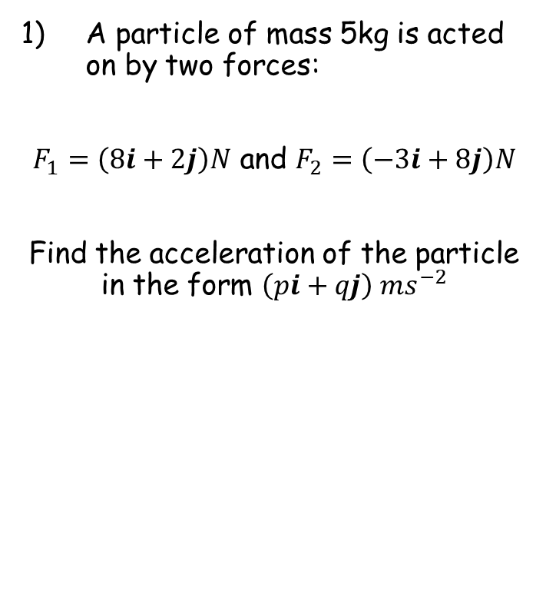




Prior knowledge check
A particle of mass 5kg is acted on by two forces:
$F_{1}=\left(8i+2j\right)N$ and $F_{2}=\left(−3i+8j\right)N$
Find the acceleration of the particle in the form $\left(pi+qj\right) {ms}^{−2}$
2) In the diagram below, calculate:
The length of the hypotenuse
The size of $α$
$$16.55$$
$${25.02}^{°}$$
$$7$$
$$\left(i+2j\right) {ms}^{−2}$$
$$α$$
$$15$$

Slide 3
Teachings for
Exercise 5A

Slide 4
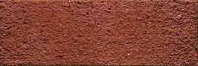
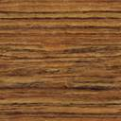
Forces and Friction
However, a force at an angle will have some effect in BOTH the horizontal and vertical directions!
If a force at applied at an angle to the direction of motion you can resolve it to find the component of the force acting in the direction of motion
O
A
O
S
H
C
H
T
A
A horizontal force has no effect on the object in the vertical direction
Opp = Sinθ x Hyp
Adj = Cosθ x Hyp
10N
Opp = Sin20 x 10
Adj = Cos20 x 10
Hyp
10N
Opp
10sin20
20°
Adj
10N
10cos20
A vertical force has no effect on the object in the horizontal direction
So a force can be split into its horizontal and vertical components using Trigonometry!
5A

Slide 5
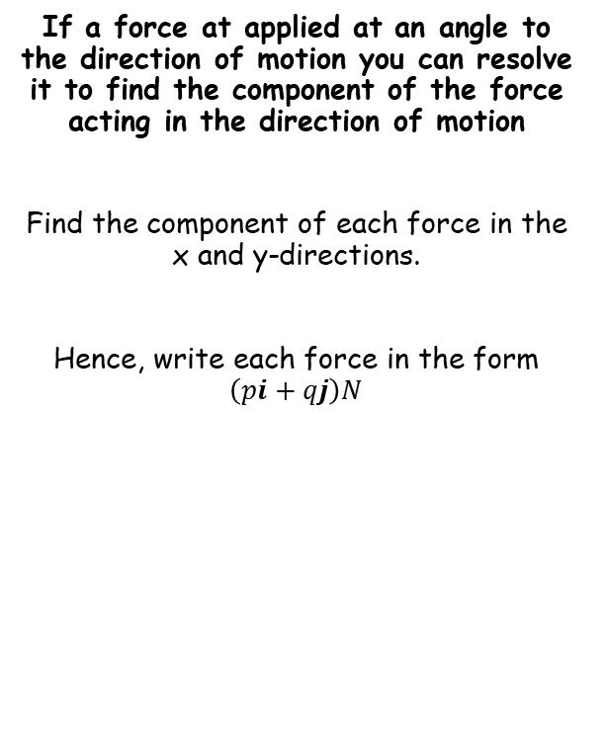
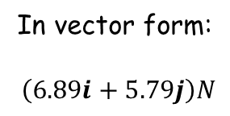
Forces and Friction
y
If a force at applied at an angle to the direction of motion you can resolve it to find the component of the force acting in the direction of motion
Find the component of each force in the x and y-directions.
Hence, write each force in the form $\left(pi+qj\right)N$
9N
9Sin40
40°
x
9Cos40
Force in the x-direction
Force in the y-direction
= 9Cos40
= 9Sin40
= 6.89N
= 5.79N
In vector form:
$\left(6.89i+5.79j\right)N$
5A

Slide 6
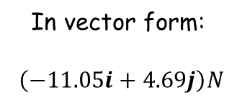
Forces and Friction
y
If a force at applied at an angle to the direction of motion you can resolve it to find the component of the force acting in the direction of motion
Find the component of each force in the x and y-directions.
Hence, write each force in the form $\left(pi+qj\right)N$
12N
12Sin23
23°
x
12Cos23
Force in the x-direction
Force in the y-direction
In vector form:
$\left(−11.05i+4.69j\right)N$
= 12Cos23
= 12Sin23
= 11.05N
= 4.69N
= -11.05N
(This will be negative as it is the opposite direction to x!)
5A

Slide 7
Forces and Friction
Draw a diagram and label all forces
R
10N
If a force at applied at an angle to the direction of motion you can resolve it to find the component of the force acting in the direction of motion
A box of mass 8kg lies on a smooth horizontal floor. A force of 10N is applied at an angle of 30˚ causing the box to accelerate horizontally across the floor.
Work out the acceleration of the box
Calculate the normal reaction between the box and the floor
10sin30
8kg
30˚
10cos30
8g
In this example, the directions we are considering are horizontal (for movement) and vertical (for the normal reaction)
Any forces which are not horizontal or vertical need to be split into their component parts in those directions
In this case, that would be the ‘diagonal’ force of 10N
5A

Slide 8







Forces and Friction
Draw a diagram and label all forces
R
10N
If a force at applied at an angle to the direction of motion you can resolve it to find the component of the force acting in the direction of motion
A box of mass 8kg lies on a smooth horizontal floor. A force of 10N is applied at an angle of 30˚ causing the box to accelerate horizontally across the floor.
Work out the acceleration of the box
Calculate the normal reaction between the box and the floor
10sin30
8kg
30˚
10cos30
8g
To find the acceleration, we need to consider only horizontal forces, and then use $F=ma$
$$R(→)$$
$$F=ma$$
$$a=1.08 {ms}^{−2}$$
Sub in values
$$10cos30=(8)(a)$$
$$\frac{5\sqrt{3}}{8}=a$$
Calculate
Round to 3sf (or leave exact)
This means we will resolve forces in the horizontal direction, with ‘to the right’ as ‘positive’
→ You need to indicate this when resolving…
$$1.08=a$$
5A

Slide 9






Forces and Friction
Draw a diagram and label all forces
R
10N
If a force at applied at an angle to the direction of motion you can resolve it to find the component of the force acting in the direction of motion
A box of mass 8kg lies on a smooth horizontal floor. A force of 10N is applied at an angle of 30˚ causing the box to accelerate horizontally across the floor.
Work out the acceleration of the box
Calculate the normal reaction between the box and the floor
10sin30
8kg
30˚
10cos30
8g
To find the normal reaction, we need to consider only vertical forces, and then use $F=ma$
$$R(↑)$$
$$F=ma$$
Sub in values. Add on positive forces, subtract negative forces. The acceleration in the vertical direction is 0
$$a=1.08 {ms}^{−2}$$
$$R+10sin30−8g=(8)(0)$$
Rearrange
$$R=8g−10sin30$$
This means we will resolve forces in the vertical direction, with ‘upwards’ as ‘positive’
→ You need to indicate this when resolving…
Calculate
$$R=73.4N$$
Without the force, the normal reaction would be the same as the weight of the box.
→ Since the force is pulling the box up slightly, this is why the normal reaction is less!
5A

Slide 10


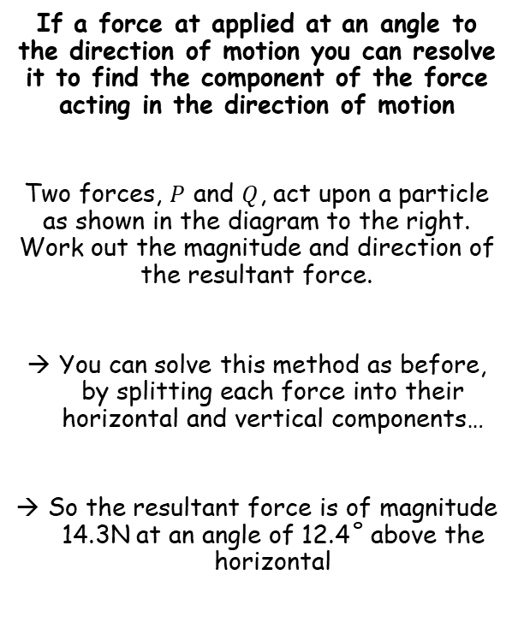




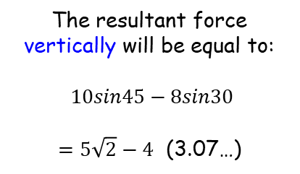


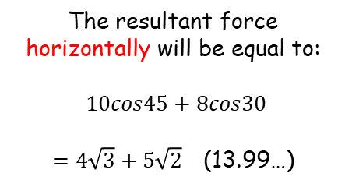


Forces and Friction
10N
10sin45
If a force at applied at an angle to the direction of motion you can resolve it to find the component of the force acting in the direction of motion
Two forces, $P$ and $Q$, act upon a particle as shown in the diagram to the right. Work out the magnitude and direction of the resultant force.
You can solve this method as before, by splitting each force into their horizontal and vertical components…
So the resultant force is of magnitude 14.3N at an angle of 12.4˚ above the horizontal
45˚
10cos45
30˚
8cos30
8sin30
8N
The resultant force horizontally will be equal to:
$10cos45+8cos30$
$=4\sqrt{3}+5\sqrt{2}$ (13.99…)
The resultant force vertically will be equal to:
$10sin45−8sin30$
$=5\sqrt{2}−4$ (3.07…)
$$14.3N$$
$$3.07N$$
$${12.4}^{°}$$
$$θ$$
Magnitude
$$13.99N$$
Angle $θ$
$$=\sqrt{{(13.99)}^{2}+{(3.07)}^{2}}$$
$$={Tan}^{−1}\left(\frac{3.07}{13.99}\right)$$
$$=14.3N$$
$$=12.4^{°}$$
5A

Slide 11
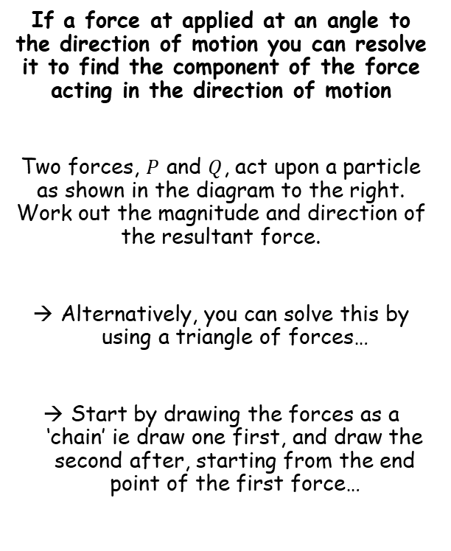
Forces and Friction
10N
If a force at applied at an angle to the direction of motion you can resolve it to find the component of the force acting in the direction of motion
Two forces, $P$ and $Q$, act upon a particle as shown in the diagram to the right. Work out the magnitude and direction of the resultant force.
Alternatively, you can solve this by using a triangle of forces…
Start by drawing the forces as a ‘chain’ ie draw one first, and draw the second after, starting from the end point of the first force…
45˚
30˚
8N
→ Draw forces one after another…
30˚
105˚
10N
8N
45˚
30˚
→ You will then need to find an angle inside the triangle, and use the sine or cosine rule…
5A

Slide 12




Forces and Friction
10N
If a force at applied at an angle to the direction of motion you can resolve it to find the component of the force acting in the direction of motion
Two forces, $P$ and $Q$, act upon a particle as shown in the diagram to the right. Work out the magnitude and direction of the resultant force.
Alternatively, you can solve this by using a triangle of forces…
Start by drawing the forces as a ‘chain’ ie draw one first, and draw the second after, starting from the end point of the first force…
45˚
30˚
8N
→ You will then need to find an angle inside the triangle, and use the sine or cosine rule…
$$14.3N$$
30˚
105˚
10N
8N
$$a^{2}=b^{2}+c^{2}−2bcCosA$$
Sub in values
$$a^{2}={(8)}^{2}+{(10)}^{2}−2\left(8\right)(10)Cos105$$
Calculate
$$a=14.3N$$
5A

Slide 13





Forces and Friction
10N
If a force at applied at an angle to the direction of motion you can resolve it to find the component of the force acting in the direction of motion
Two forces, $P$ and $Q$, act upon a particle as shown in the diagram to the right. Work out the magnitude and direction of the resultant force.
Alternatively, you can solve this by using a triangle of forces…
Start by drawing the forces as a ‘chain’ ie draw one first, and draw the second after, starting from the end point of the first force…
45˚
30˚
8N
→ You will then need to find an angle inside the triangle, and use the sine or cosine rule…
$$14.3N$$
30˚
105˚
10N
8N
$$\frac{SinA}{a}=\frac{SinB}{b}$$
Sub in values
$$\frac{SinA}{10}=\frac{Sin105}{14.3}$$
Calculate
$$SinA=0.675…$$
Calculate
$$A=42.4…$$
Subtract 30 to find the angle above the horizontal
$$Direction=12.4…$$
5A

Slide 14
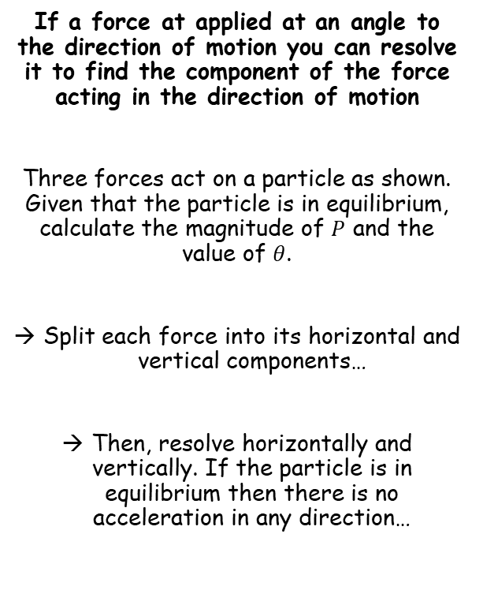




Forces and Friction
140N
If a force at applied at an angle to the direction of motion you can resolve it to find the component of the force acting in the direction of motion
Three forces act on a particle as shown. Given that the particle is in equilibrium, calculate the magnitude of $P$ and the value of $θ$.
Split each force into its horizontal and vertical components…
Then, resolve horizontally and vertically. If the particle is in equilibrium then there is no acceleration in any direction…
100N
140sin45
100sin30
45˚
30˚
140cos45
Pcosθ
100cos30
θ
Psinθ
P
$$R(→)$$
$$F=ma$$
Sub in values
$$100cos30+Pcosθ−140cos45=0$$
Rearrange
$$Pcosθ=140cos45−100cos30$$
$$R(↓)$$
$$F=ma$$
Sub in values
$$Psinθ−100sin30−140sin45=0$$
Rearrange
$$Pcosθ=140cos45−100cos30$$
$$Psinθ=100sin30+140sin45$$
$$Psinθ=100sin30+140sin45$$
5A

Slide 15



Forces and Friction
140N
If a force at applied at an angle to the direction of motion you can resolve it to find the component of the force acting in the direction of motion
Three forces act on a particle as shown. Given that the particle is in equilibrium, calculate the magnitude of $P$ and the value of $θ$.
Split each force into its horizontal and vertical components…
Then, resolve horizontally and vertically. If the particle is in equilibrium then there is no acceleration in any direction…
100N
140sin45
100sin30
45˚
30˚
140cos45
Pcosθ
100cos30
θ
Psinθ
P
1)
$$Psinθ=100sin30+140sin45$$
2)
$$Pcosθ=140cos45−100cos30$$
1) ÷ 2)
$$tanθ=\frac{100sin30+140sin45}{140cos45−100cos30}$$
Calculate
$$θ=85.2^{°}$$
You can use this value in either 1) or 2) to find the value of P
$$P=150N$$
5A

Slide 16
Teachings for
Exercise 5B

Slide 17
Forces and Friction
Note that when using an inclined plane, we use the terminology ‘parallel’ for movement direction and ‘perpendicular’ for the normal reaction
This is actually exactly the same as with a horizontal plane!
(horizontal = parallel and vertical = perpendicular)
You can extend this process to particles on an inclined plane, by considering forces parallel and perpendicular to the plane
Horizontal plane
Inclined plane
Normal reaction
Normal reaction
Direction of movement
Direction of movement
Weight
Weight
→ We resolve horizontally for the direction of movement
→ We resolve vertically for the normal reaction
→ The weight acts vertically
→ We resolve parallel to the plane for the direction of movement
→ We resolve perpendicular to the plane for the normal reaction
→ The weight still acts vertically
5B

Slide 18
Forces and Friction
R
You can extend this process to particles on an inclined plane, by considering forces parallel and perpendicular to the plane
When an object is on an inclined plane, we consider the forces acting parallel to the plane and perpendicular to the plane (instead of vertically and horizontally)
This is because any movement will be parallel to the plane (and we always then consider the direction which is perpendicular to any movement)
However, gravity will always work in a vertical direction so must be split into parallel and perpendicular directions…
3kg
60°
30°
3gCos30
3g
30°
90°
3gSin30
Above is a box resting on a plane inclined at an angle of 30° to the horizontal
→ Label gravity, which always acts vertically downwards
→ Gravity must then be split into the parallel and perpendicular components (rather than horizontal and vertical)
→ The angle in the triangle created is the same as the angle the plane is inclined at (if you work out angles you can see why!)
→ Make sure you think carefully about which is Sine and which is Cosine!
→ Don’t forget the normal reaction, and any other forces which are involved in the question!
5B

Slide 19





Forces and Friction
R
2N
You can extend this process to particles on an inclined plane, by considering forces parallel and perpendicular to the plane
A box of mass 2kg is resting on a smooth plane inclined at an angle of 20° to the horizontal. It meets resistance of 2N as it travels down the slope
a) Calculate the acceleration of the box down the slope
b) If the box starts 10m up the plane, calculate the velocity of the box at the bottom of the plane
2kg
2gCos20
2g
20°
20°
2gSin20
Resolve parallel to the plane
$$R(↙)$$
$$F=ma$$
Sub in values and resolve parallel
$$2gSin20−2=(2×a)$$
Work out some parts (to keep accuracy)
$$19.6Sin20−2=2a$$
Round to 2sf as gravity is given to this degree of accuracy
$$2.4=a (2sf)$$
5B

Slide 20










Forces and Friction
R
2N
You can extend this process to particles on an inclined plane, by considering forces parallel and perpendicular to the plane
A box of mass 2kg is resting on a smooth plane inclined at an angle of 20° to the horizontal. It meets resistance of 2N as it travels down the slope
a) Calculate the acceleration of the box down the slope – 2.4ms⁻²
b) If the box starts 10m up the plane, calculate the velocity of the box at the bottom of the plane
2kg
2gCos20
2g
20°
20°
2gSin20
$$s=10$$
$$u=0$$
$$v=?$$
$$a=2.4$$
$$t=?$$
$$v^{2}=u^{2}+2as$$
Sub in values
$$v^{2}=0^{2}+2(2.4)(10)$$
Remember to use the exact value for a, not the rounded one!
$$v^{2}=0^{2}+2(2.4)(10)$$
Calculate
$$v^{2}=47.03…$$
Square root
$$v=6.6ms^{−1} (2sf)$$
5B

Slide 21





Forces and Friction
R
2N
You can extend this process to particles on an inclined plane, by considering forces parallel and perpendicular to the plane
A box of mass 2kg is resting on a smooth plane inclined at an angle of 20° to the horizontal. It meets resistance of 2N as it travels down the slope
a) Calculate the acceleration of the box down the slope – 2.4ms⁻²
b) If the box starts 10m up the plane, calculate the velocity of the box at the bottom of the plane - 6.6ms⁻¹
c) Find the normal reaction between the box and the plane
2kg
2gCos20
2g
20°
20°
2gSin20
Resolve perpendicular to the plane
$$R(↖)$$
$$F=ma$$
Sub in values and resolve perpendicular (no acceleration in this direction)
$$R−2gcos20=(2×0)$$
Rearrange
$$R=2gcos20$$
Round to 2sf as gravity is given to this degree of accuracy
$$R=18N$$
5B

Slide 22








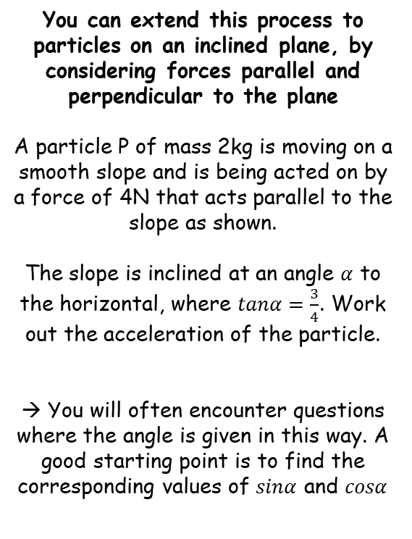











Forces and Friction
Ensure you label all forces and split into their parallel and perpendicular components…
$$R$$
You can extend this process to particles on an inclined plane, by considering forces parallel and perpendicular to the plane
A particle P of mass 2kg is moving on a smooth slope and is being acted on by a force of 4N that acts parallel to the slope as shown.
The slope is inclined at an angle $α$ to the horizontal, where $tanα=\frac{3}{4}$. Work out the acceleration of the particle.
→ You will often encounter questions where the angle is given in this way. A good starting point is to find the corresponding values of $sinα$ and $cosα$
$$2kg$$
$$2gcosα$$
$$α$$
$$4N$$
$$2g$$
$$α$$
$$2gsinα$$
Remember that $Tanα=\frac{Opp}{Adj}$
$$5$$
$$3$$
In this case, $Tanα=\frac{3}{4}$
$$α$$
So draw a triangle with angle $α$, opposite side 3 and adjacent side 4
$$4$$
→ So the hypotenuse will be 5
$$Sinα=\frac{Opp}{Hyp}$$
$$Cosα=\frac{Adj}{Hyp}$$
$$Sinα=\frac{3}{5}$$
$$Cosα=\frac{4}{5}$$
5B

Slide 23




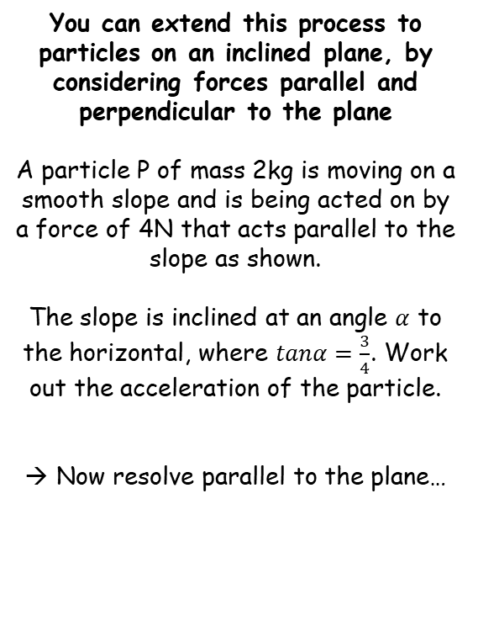
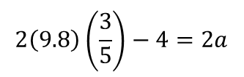




Forces and Friction
$$R$$
$$Sinα=\frac{3}{5}$$
Ensure you label all forces and split into their parallel and perpendicular components…
You can extend this process to particles on an inclined plane, by considering forces parallel and perpendicular to the plane
A particle P of mass 2kg is moving on a smooth slope and is being acted on by a force of 4N that acts parallel to the slope as shown.
The slope is inclined at an angle $α$ to the horizontal, where $tanα=\frac{3}{4}$. Work out the acceleration of the particle.
Now resolve parallel to the plane…
$$2kg$$
$$Cosα=\frac{4}{5}$$
$$2gcosα$$
$$Tanα=\frac{3}{4}$$
$$α$$
$$4N$$
$$2g$$
$$α$$
$$2gsinα$$
Resolve parallel to the plane
$$R(↙)$$
$$F=ma$$
Sub in values and resolve parallel
(you can choose up or down the slope)
$$2gSinα−4=(2×a)$$
$$2\left(9.8\right)\left(\frac{3}{5}\right)−4=2a$$
We can use values for $g$ and $sinα$
Calculate
$$3.9=a (2sf)$$
If we had resolved up the slope instead, the acceleration would have been negative
→ You can interpret this as being in the opposite direction to the resolving
5B

Slide 24








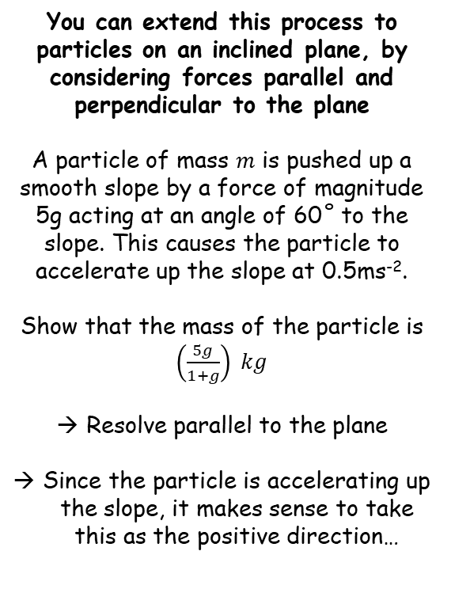


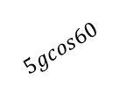








Forces and Friction
$$R$$
You can extend this process to particles on an inclined plane, by considering forces parallel and perpendicular to the plane
A particle of mass $m$ is pushed up a smooth slope by a force of magnitude 5g acting at an angle of 60˚ to the slope. This causes the particle to accelerate up the slope at 0.5ms⁻².
Show that the mass of the particle is $\left(\frac{5g}{1+g}\right) kg$
Resolve parallel to the plane
Since the particle is accelerating up the slope, it makes sense to take this as the positive direction…
Ensure you label all forces and split into their parallel and perpendicular components…
$$5g$$
$$m kg$$
$$5gsin60$$
$${60}^{°}$$
$$mgcos30$$
$$mg$$
$${30}^{°}$$
$$5gcos60$$
$${30}^{°}$$
$$mgsin30$$
Resolve parallel to the plane
$$R(↗)$$
$$F=ma$$
Sub in values
$$5gcos60−mgsin30=(m)(0.5)$$
Add $mgsin30$
$$5gcos60=0.5m+mgsin30$$
Cos60 and Sin30 are both equal to 0.5
$$2.5g=0.5m+0.5mg$$
Multiply by 2
$$5g=m+mg$$
Factorise right side
$$5g=m(1+g)$$
Divide by the bracketed part
$$\frac{5g}{1+g}=m$$
5B

Slide 25
Teachings for
Exercise 5C

Slide 26



Forces and Friction
You can calculate the magnitude of a frictional force using the coefficient of friction
Friction is a force which opposes movement between two ‘rough’ surfaces.
It is dependent on two things:
1) The normal reaction between the two surfaces
2) The coefficient of friction between the two surfaces
The maximum frictional force is calculated as follows:
If a surface is described as ‘smooth’, the implication is that the coefficient of friction is 0.
$$F_{MAX}=μR$$
$$μ=coefficient of Friction$$
$$R=the normal reaction$$
5C

Slide 27
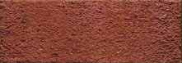










Forces and Friction
a ms⁻²
Draw a diagram
You can calculate the magnitude of a frictional force using the coefficient of friction
Friction is a force which opposes movement between two ‘rough’ surfaces.
A block of mass 5kg is lying at rest on rough horizontal ground. The coefficient of friction between the block and the ground is 0.4. A horizontal force, P, is applied to the block. Find the magnitude of the frictional force acting on the block and its acceleration when:
P = 10N
P = 19.6N
P = 30N
R
F
5kg
10N
$$F_{MAX}=μR$$
$$μ=coefficient of Friction$$
$$R=the normal reaction$$
5g N
We need to find the maximum possible frictional force
→ To do this we need R, the normal reaction
$$R(↑)$$
$$F=ma$$
Resolve vertically
$R−5g=(5×0$)
Calculate R
$$R=5g (49N)$$
Now we can calculate the maximum possible frictional force
$$F_{MAX}=μR$$
Sub in values
$$F_{MAX}=(0.4×49)$$
$$F_{MAX}=19.6N$$
Calculate F_{MAX}
5C

Slide 28

Forces and Friction
a ms⁻²
Draw a diagram
You can calculate the magnitude of a frictional force using the coefficient of friction
Friction is a force which opposes movement between two ‘rough’ surfaces.
A block of mass 5kg is lying at rest on rough horizontal ground. The coefficient of friction between the block and the ground is 0.4. A horizontal force, P, is applied to the block. Find the magnitude of the frictional force acting on the block and its acceleration when:
P = 10N
P = 19.6N
P = 30N
R
$$F_{MAX}=19.6N$$
10N
F
5kg
10N
$$F_{MAX}=μR$$
$$μ=coefficient of Friction$$
$$R=the normal reaction$$
5g N
The maximum frictional force is 19.6 N
Any force will be opposed by friction up to this value
For part a), the force is only 10N
Therefore, the frictional force will match this at 10N, preventing movement
Hence, there is also no acceleration
5C

Slide 29
Forces and Friction
a ms⁻²
Draw a diagram
You can calculate the magnitude of a frictional force using the coefficient of friction
Friction is a force which opposes movement between two ‘rough’ surfaces.
A block of mass 5kg is lying at rest on rough horizontal ground. The coefficient of friction between the block and the ground is 0.4. A horizontal force, P, is applied to the block. Find the magnitude of the frictional force acting on the block and its acceleration when:
P = 10N
P = 19.6N
P = 30N
R
$$F_{MAX}=19.6N$$
19.6N
F
5kg
19.6N
$$F_{MAX}=μR$$
$$μ=coefficient of Friction$$
$$R=the normal reaction$$
5g N
The maximum frictional force is 19.6 N
Any force will be opposed by friction up to this value
For part b), the force is only 19.6N
Therefore, the frictional force will match this at 19.6N, preventing movement
Hence, there is also no acceleration
This situation is called ‘limiting equilibrium’, as the object is on the point of movement
5C

Slide 30





Forces and Friction
a ms⁻²
Draw a diagram
You can calculate the magnitude of a frictional force using the coefficient of friction
Friction is a force which opposes movement between two ‘rough’ surfaces.
A block of mass 5kg is lying at rest on rough horizontal ground. The coefficient of friction between the block and the ground is 0.4. A horizontal force, P, is applied to the block. Find the magnitude of the frictional force acting on the block and its acceleration when:
P = 10N
P = 19.6N
P = 30N
R
$$F_{MAX}=19.6N$$
19.6N
F
5kg
30N
$$F_{MAX}=μR$$
$$μ=coefficient of Friction$$
$$R=the normal reaction$$
5g N
For part c), the force is 30N
The frictional force will oppose 19.6N of this, but no more.
Hence, the object will accelerate…
Resolve horizontally!
$$R(→)$$
$$F=ma$$
Sub in values and resolve horizontally
$$30−19.6=\left(5×a\right)$$
Calculate
$$10.4=5a$$
Divide by 5
$$2.08=a$$
So the acceleration will be 2.08ms⁻²
5C

Slide 31






Forces and Friction
R
Draw a diagram
You can calculate the magnitude of a frictional force using the coefficient of friction
Friction is a force which opposes movement between two ‘rough’ surfaces.
A 5kg box lies at rest on a rough horizontal floor. The coefficient of friction between the box and the floor is 0.5. A force P is applied to the box. Calculate the value of P required to cause the box to accelerate if:
P is applied horizontally
P is applied at an angle of θ above the horizontal, where tanθ = ³/₄
F
5kg
P
5g N
$$F_{MAX}=μR$$
$$μ=coefficient of Friction$$
$$R=the normal reaction$$
Resolve vertically to find the normal reaction
$$R(↑)$$
$$F=ma$$
Sub in values and resolve vertically
$$R−5g=(5×0)$$
Calculate
$$R=49N$$
Now find the maximum frictional force
$$F_{MAX}=μR$$
Sub in values
$$F_{MAX}=(0.5×49)$$
Calculate
$$F_{MAX}=24.5N$$
So P will have to exceed 24.5N to make the object move!
5C

Slide 32
Forces and Friction
Draw a diagram
R
P
You can calculate the magnitude of a frictional force using the coefficient of friction
Friction is a force which opposes movement between two ‘rough’ surfaces.
A 5kg box lies at rest on a rough horizontal floor. The coefficient of friction between the box and the floor is 0.5. A force P is applied to the box. Calculate the value of P required to cause the box to accelerate if:
P is applied horizontally – 24.5N
P is applied at an angle of θ above the horizontal, where tanθ = ³/₄
Psinθ
0.6P
F
5kg
θ
Pcosθ
0.8P
5g N
$$F_{MAX}=μR$$
$$μ=coefficient of Friction$$
We need to find the values of Cosθ and Sinθ. The ratio for Tanθ can be used to find these!
$$R=the normal reaction$$
O
A
O
Tanθ = ³/₄
S
H
C
H
T
A
So Opp = 3
And Adj = 4
Hyp
We can find the hypotenuse using Pythagoras’ Theorem!
5
3
Opp
θ
4
Adj
Sinθ = ³/₅
Cosθ = ⁴/₅
Sinθ = 0.6
Cosθ = 0.8
5C

Slide 33





Forces and Friction
Draw a diagram
R
P
You can calculate the magnitude of a frictional force using the coefficient of friction
Friction is a force which opposes movement between two ‘rough’ surfaces.
A 5kg box lies at rest on a rough horizontal floor. The coefficient of friction between the box and the floor is 0.5. A force P is applied to the box. Calculate the value of P required to cause the box to accelerate if:
P is applied horizontally – 24.5N
P is applied at an angle of θ above the horizontal, where tanθ = ³/₄
0.6P
F
5kg
θ
0.8P
5g N
$$F_{MAX}=μR$$
$$μ=coefficient of Friction$$
Resolve vertically to find the normal reaction
$$R=the normal reaction$$
$$R(↑)$$
$$F=ma$$
Sub in values and resolve vertically
$$R+0.6P−5g=(5×0)$$
We find the normal reaction in terms of P
$$R=49−0.6P$$
Now find the maximum frictional force
$$F_{MAX}=μR$$
Sub in values
$$F_{MAX}=0.5(49−0.6P)$$
Find F_{max} in terms of P
$$F_{MAX}=24.5−0.3P$$
So, 0.8P will have to exceed this if the box is to move…
5C

Slide 34







Forces and Friction
Draw a diagram
$$F_{MAX}=24.5−0.3P$$
R
P
You can calculate the magnitude of a frictional force using the coefficient of friction
Friction is a force which opposes movement between two ‘rough’ surfaces.
A 5kg box lies at rest on a rough horizontal floor. The coefficient of friction between the box and the floor is 0.5. A force P is applied to the box. Calculate the value of P required to cause the box to accelerate if:
P is applied horizontally – 24.5N
P is applied at an angle of θ above the horizontal, where tanθ = ³/₄
0.6P
24.5 – 0.3P
θ
F
5kg
0.8P
5g N
$$F_{MAX}=μR$$
$$μ=coefficient of Friction$$
We need to find the value for P for which the box is in ‘limiting equilibrium’ – that is, so the horizontal forces cancel each other out…
$$R=the normal reaction$$
Resolve horizontally…
$$R(→)$$
$$F=ma$$
Sub in values and resolve horizontally
$$0.8P−(24.5−0.3P)=(5×0)$$
Careful with the bracket!
$$0.8P−24.5+0.3P=0$$
Rearrange and solve
$$1.1P=24.5$$
$$P=22N (2sf)$$
P must exceed 22N, which is less than when P was horizontal
→ The reason is because some of the force is upwards, this alleviates some of the friction between the surfaces…
5C

Slide 35



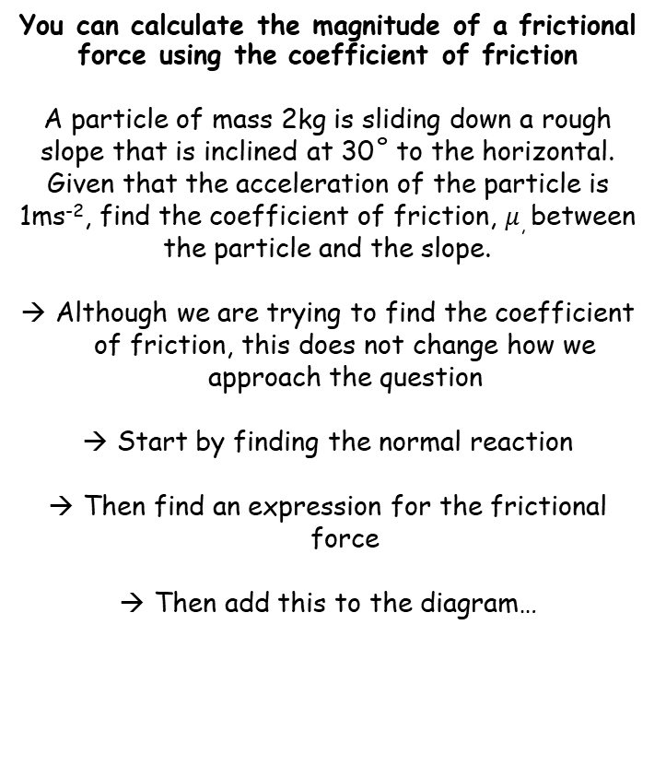












Forces and Friction
$$F_{MAX}=μR$$
$$μ(2gcos30)$$
$$2gcos30$$
$$Friction$$
$$R$$
Draw and fully label a diagram!
You can calculate the magnitude of a frictional force using the coefficient of friction
A particle of mass 2kg is sliding down a rough slope that is inclined at 30˚ to the horizontal. Given that the acceleration of the particle is 1ms⁻², find the coefficient of friction, $μ$, between the particle and the slope.
Although we are trying to find the coefficient of friction, this does not change how we approach the question
Start by finding the normal reaction
Then find an expression for the frictional force
Then add this to the diagram…
$$2kg$$
$$2gcos30$$
$$2g$$
$${30}^{°}$$
$${30}^{°}$$
$$2gsin30$$
Resolve perpendicular to find the normal reaction
$$R(↖)$$
$$F=ma$$
Sub in values and resolve perpendicular
$$R−2gcos30=(2×0)$$
We find the normal reaction in terms of P
$$R=2gcos30$$
Now find the maximum frictional force
$$F_{MAX}=μR$$
Sub in R
$$F_{MAX}=μ(2gcos30)$$
Since the particle is moving, the friction must be at this level
Add this information to the diagram…
5C

Slide 36









Forces and Friction
$$F_{MAX}=μR$$
$$2gcos30$$
$$μ(2gcos30)$$
Draw and fully label a diagram!
You can calculate the magnitude of a frictional force using the coefficient of friction
A particle of mass 2kg is sliding down a rough slope that is inclined at 30˚ to the horizontal. Given that the acceleration of the particle is 1ms⁻², find the coefficient of friction, $μ$, between the particle and the slope.
$$2kg$$
$$2gcos30$$
$$2g$$
$${30}^{°}$$
$${30}^{°}$$
$$2gsin30$$
Resolve parallel to the plane…
$$R(↙)$$
$$F=ma$$
Sub in values and resolve perpendicular
$$2gsin30−μ(2gcos30)=(2×1)$$
Rearrange to isolate $μ$
$$2gsin30−(2×1)=μ(2gcos30)$$
$$\frac{2gsin30−(2×1)}{2gcos30}=μ$$
Divide by $2gcos30$
Calculate
$$0.46=μ$$
Remember that your answer should be between 0 and 1!
5C

